Slide 1
Superstore Sales Analysis
Prepared by Rohit pawar

Slide 2
problem statement
The Superstore dataset provides sales and profit data for a variety of products across different categories and regions.
The goal of this project is to analyze the data and identify insights that can help the supermarket improve its business performance.
Specifically, we aim to answer questions such as: which product categories are the most profitable? Which regions have the highest sales and profit? What are the most profitable products?
By answering these questions, we hope to provide recommendations for the company on how to optimize its product offerings and improve its revenue and profitability.

Slide 3
Gather and clean the data
Once you have defined the problem or question, you need to gather the data you'll need to analyze.
This could involve collecting data from various sources or accessing existing data sets. You'll also need to clean the data to ensure it's accurate, complete, and consistent.

Slide 4
Explore the data
Once you have your data, you'll need to explore it to get a sense of what it contains.
This might involve creating visualizations, calculating basic statistics, or conducting other exploratory analysis techniques.

Slide 5
assumptions
The superstore dataset contains a representative sample of all transactions conducted by the store during the time period covered by the dataset.
The data in the superstore dataset is accurate and has been cleaned and preprocessed prior to analysis.
The superstore dataset covers a sufficient time period to allow for the identification of trends or patterns in sales and profitability.
The Super Store dataset is not impacted by any significant outliers or anomalies that could skew the results of any analysis conducted on the dataset.

Slide 6
research questions
We’re interested in understanding which factors contribute to high sales in the superstore.
Which product categories have the highest profit margins in the Super Store?
Are there any significant differences in sales between the East region and other regions?
How do discounts vary among the segments and what it affects?

Slide 7
Formulate hypotheses
Hypothesis 1: Technology products have the highest profit margin compared to other product categories.
Hypothesis 2: The West region has the highest sales compared to other regions.
Hypothesis 3: The count of 10 Quantities is mostly preferred by the consumers.
Hypothesis 4: Majority of the sales of the supermarket is done by retail consumers.
Hypothesis 5: The Supermarket gives maximum discount for the retail consumers.

Slide 8
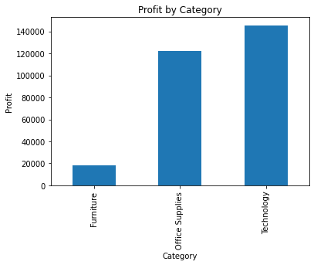
Test the hypotheses
Hypothesis 1: Technology products have the highest profit margin compared to other product categories.
The Hypothesis is supported as technology products have the highest profit margin of the three categories.

Slide 9
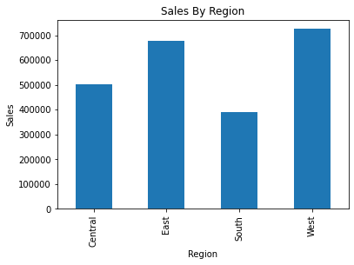
Test the hypotheses
Hypothesis 2: The East region has the highest sales compared to other regions.
The hypothesis is not supported as the West region has the highest sales

Slide 10
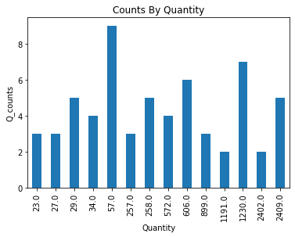
Test the hypotheses
Hypothesis 3 : Maximum number of the quantities bought are in range of 15-20
The hypothesis is not supported as the maximum quantities bought by customers ranges from 7-10.

Slide 11
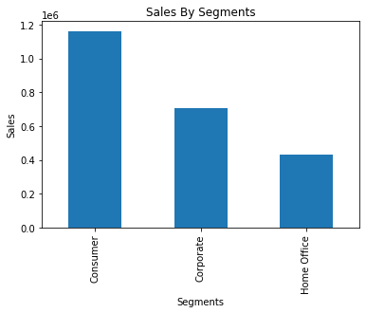
Test the hypotheses
Hypothesis 4 : Majority of sales of the Supermarket is done by Home Office segment.
The hypothesis is not supported as majority of the sales of the supermarket is done by retail consumers.
Supermarket needs to grab more of the Home Office segments.

Slide 12
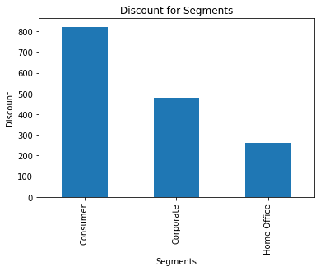
Test the hypotheses
Hypothesis 5 : Finding which segment gets the maximum discount at the supermarket.
Supermarket gives maximum discount to retail consumers so the sales of it is maximum.
Also come up with good offers for Home Office segment to increase its sales.

Slide 13
Draw conclusions
Hypothesis 1: Technology products have the highest profit margin compared to other product categories.
The Hypothesis is supported as technology products have the highest profit margin of the three categories.
Hypothesis 2: The East region has the highest sales compared to other regions.
The hypothesis is not supported as the West region has the highest sales
Hypothesis 3 : Maximum number of the quantities bought are in range of 15-20
The hypothesis is not supported as the maximum quantities bought by customers ranges from 7-10.
Hypothesis 4 : Majority of sales of the Supermarket is done by Home Office segment.
The hypothesis is not supported as majority of the sales of the supermarket is done by retail consumers.
Hypothesis 5 : Finding which segment gets the maximum discount at the supermarket.
Supermarket gives maximum discount to retail consumers so the sales of it is maximum.

Slide 14
Communicate the results
Based on the analysis, it can be concluded that technology products have the highest profit margin compared to other product categories.
Supermarket gives maximum discount to retail consumers so the sales of it is maximum.
Also come up with good offers for Home Office segment to increase its sales.
These conclusions provide valuable insights into the supermarket's performance and can guide future decision-making processes.
It is important to note that further investigation may be required to fully understand the underlying factors influencing these observations.

Slide 15
Suggestions
The Supermarket should focus on developing and promoting technology products to increase its profits. They could also consider reducing the production and promotion of products with lower profit margins.
West region has the highest sales compared to other regions; the supermarket could consider increasing its focus on this region. then the company should re-evaluate its marketing and sales strategies in other regions.
The supermarket should focus on maximizing sales in other segments also. This could involve increasing the inventory of popular products during them, running targeted marketing campaigns, and offering promotions or discounts to customers. However, the supermarket should also consider strategies to maintain sales in other categories, such as introducing new products or services or offering promotions and discounts to other segments.

